Slide 1
Towards Unsupervised Machine Translation
Adversarial
Statistical
Neural
Competitive
Deep
Amnon Lotenberg

Slide 2
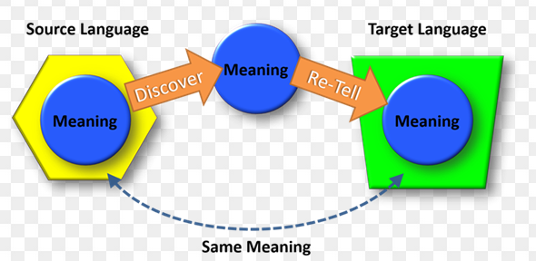
What is Machine Translation?

Slide 3
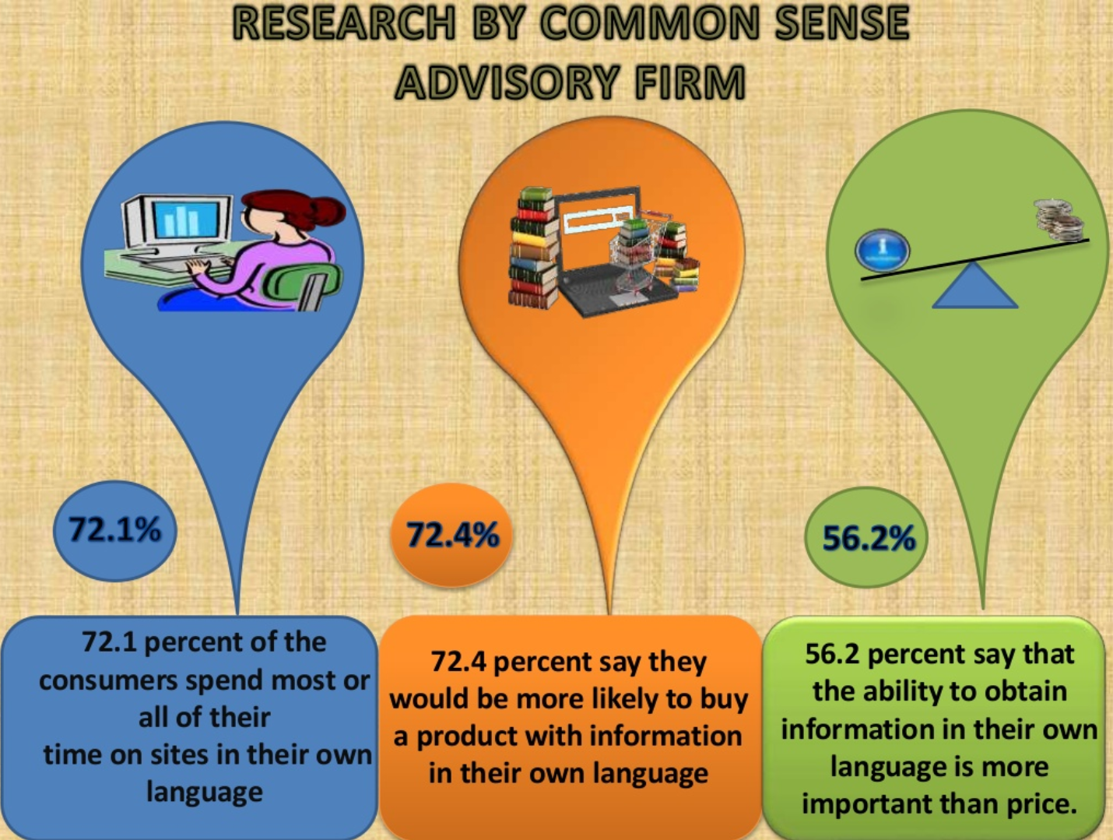
What's it good for?

Slide 4

What's it good for?

Slide 5
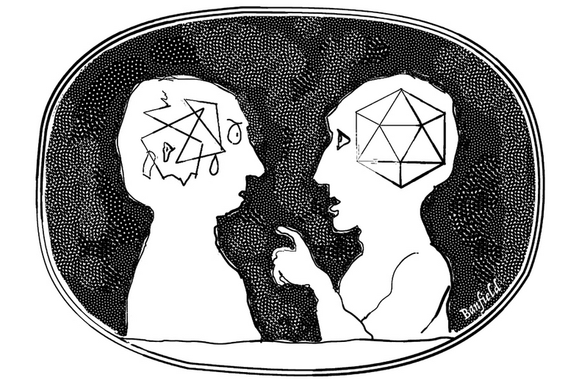


Goals of MT
Correctness
The dog chased the cat > רדף כלבלב את החתולה
Fluency (Denoise)
The dog chased the cat > החתול רדף אחרי

Slide 6
Types of MT
Source text
Statistical (Phrasal)
SMT
Neural (Deep)
NMT
Rule Based
Target text
Target text
Target text

Slide 7
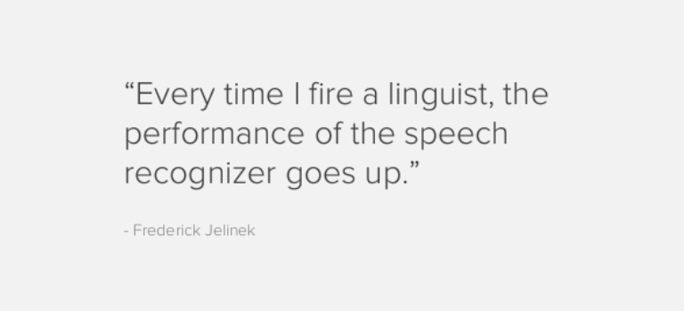
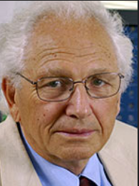
Types of MT
Source text
Statistical (Phrasal)
SMT
Neural (Deep)
NMT
Rule Based
Target text
Target text
Target text

Slide 8
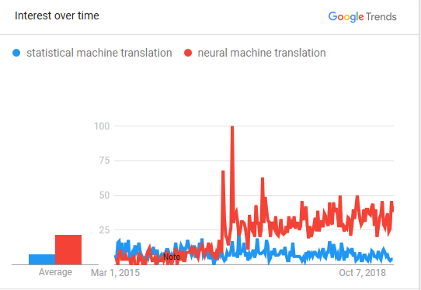

Slide 9
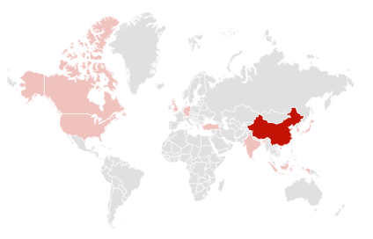
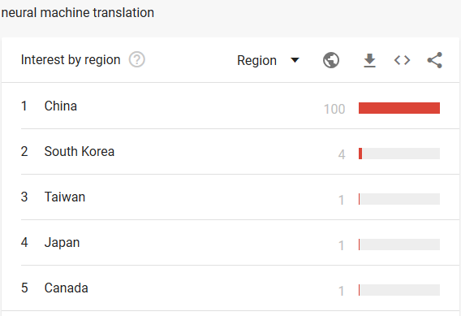

Slide 10
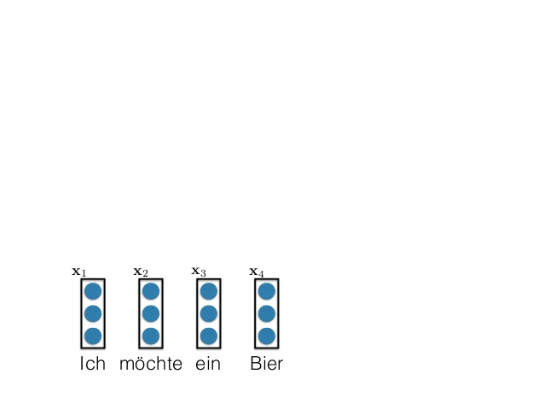
Common Architecture - Encoder
Bi-directional RNN (or LSTM)
University of Edinburgh (CC)

Slide 11
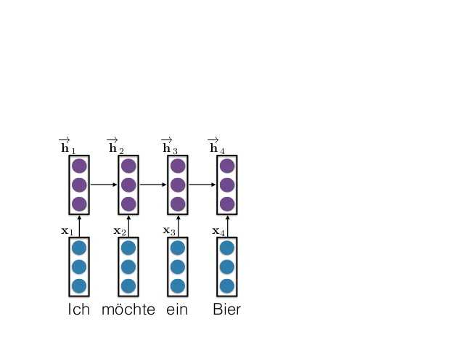
Common Architecture - Encoder
Bi-directional RNN (or LSTM)
University of Edinburgh (CC)

Slide 12
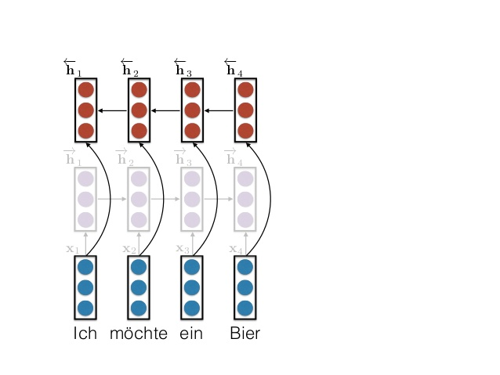
Common Architecture - Encoder
Bi-directional RNN (or LSTM)
University of Edinburgh (CC)

Slide 13
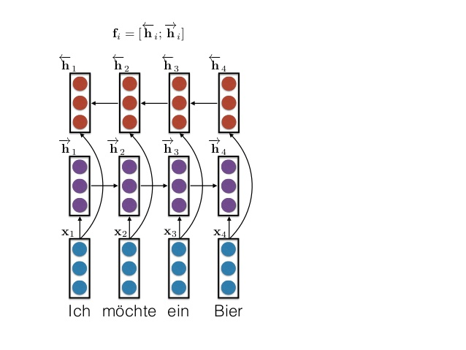
Common Architecture - Encoder
Bi-directional RNN (or LSTM)
University of Edinburgh (CC)

Slide 14
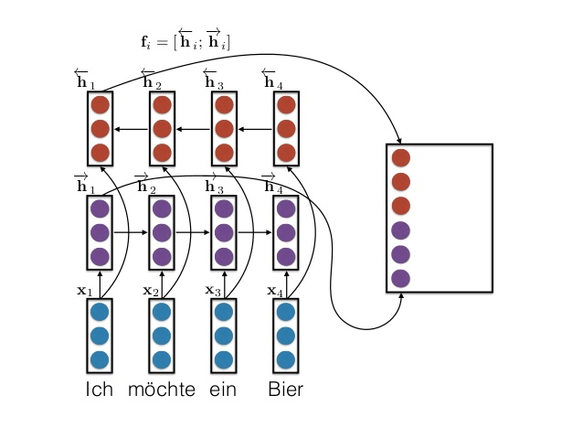
Common Architecture - Encoder
Bi-directional RNN (or LSTM)
University of Edinburgh (CC)

Slide 15
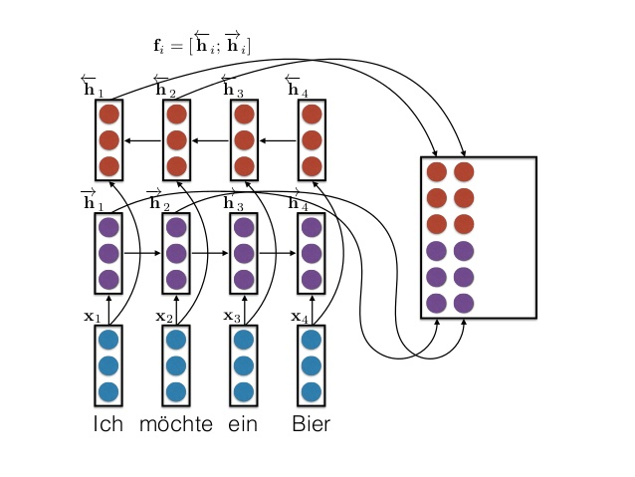
Common Architecture - Encoder
Bi-directional RNN (or LSTM)
University of Edinburgh (CC)

Slide 16
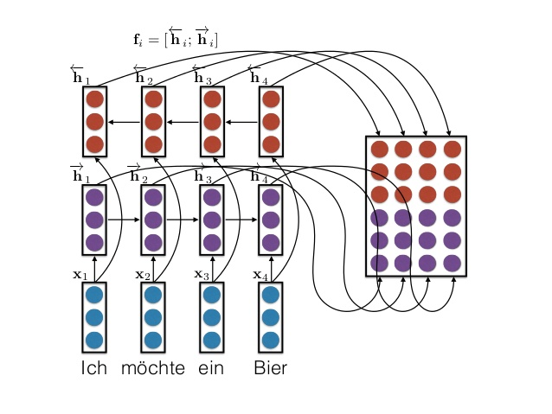
Common Architecture - Encoder
Bi-directional RNN (or LSTM)
University of Edinburgh (CC)

Slide 17
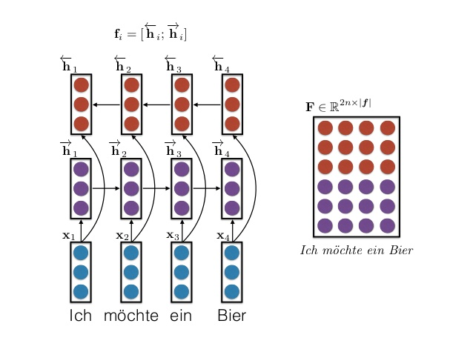
Common Architecture - Encoder
Bi-directional RNN (or LSTM)
University of Edinburgh (CC)

Slide 18
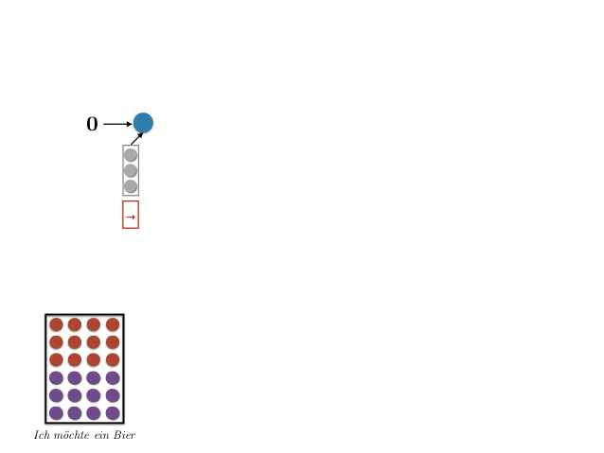
Common Architecture - Decoder
Unidirectional RNN (or LSTM) decoder, with attention
University of Edinburgh (CC)

Slide 19
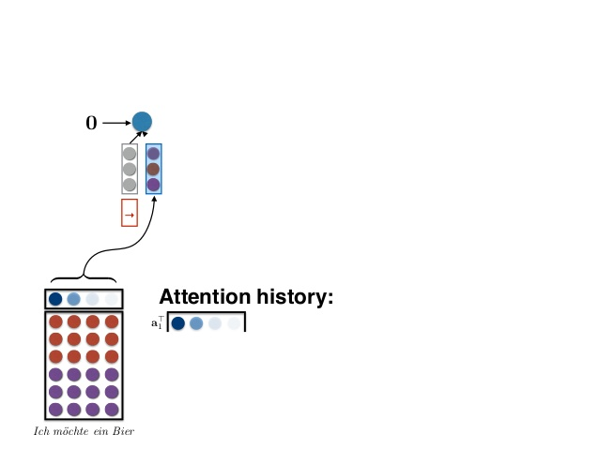
Common Architecture - Decoder
Unidirectional RNN (or LSTM) decoder, with attention
University of Edinburgh (CC)

Slide 20
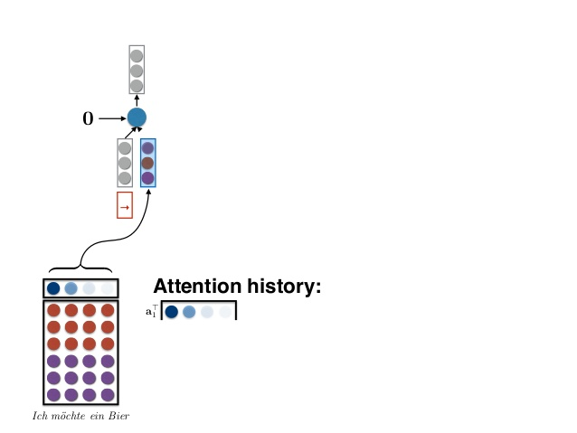
Common Architecture - Decoder
Unidirectional RNN (or LSTM) decoder, with attention
University of Edinburgh (CC)

Slide 21
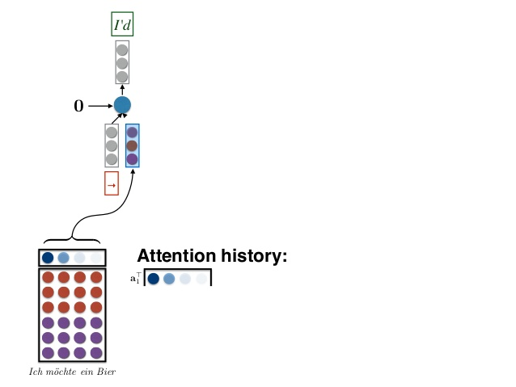
Common Architecture - Decoder
Unidirectional RNN (or LSTM) decoder, with attention
University of Edinburgh (CC)

Slide 22
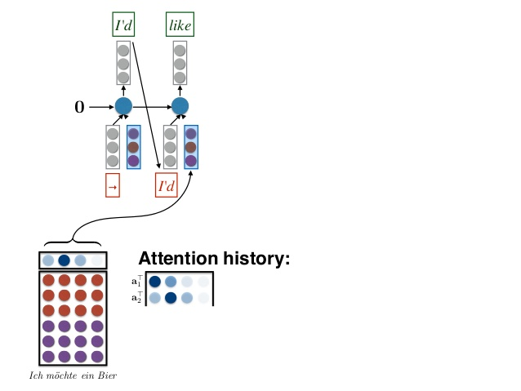
Common Architecture - Decoder
Unidirectional RNN (or LSTM) decoder, with attention
University of Edinburgh (CC)

Slide 23
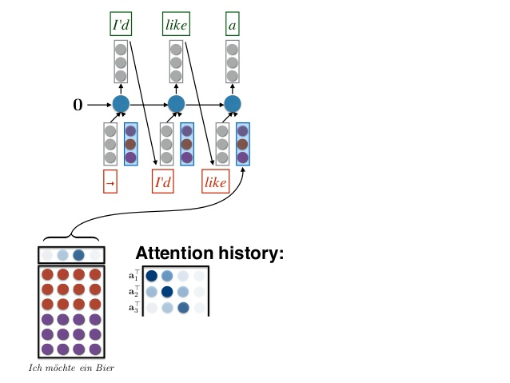
Common Architecture - Decoder
Unidirectional RNN (or LSTM) decoder, with attention
University of Edinburgh (CC)

Slide 24
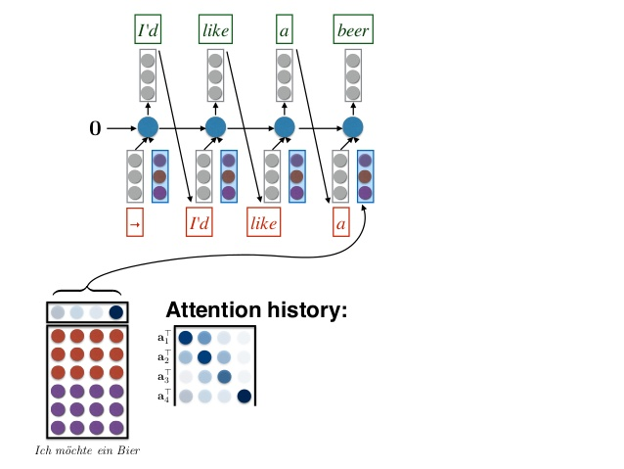
Common Architecture - Decoder
Unidirectional RNN (or LSTM) decoder, with attention
University of Edinburgh (CC)

Slide 25
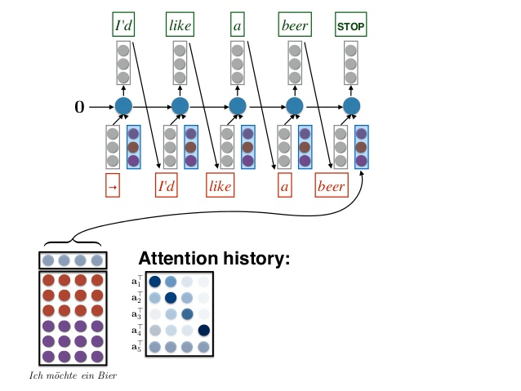
Common Architecture - Decoder
Unidirectional RNN (or LSTM) decoder, with attention
University of Edinburgh (CC)

Slide 26
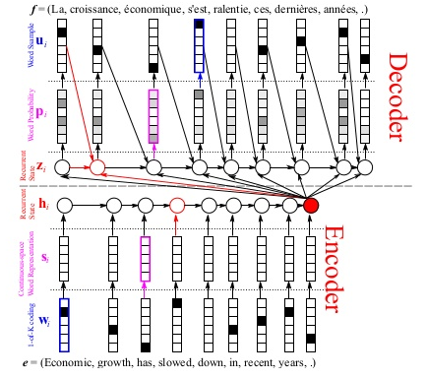
Common Architecture – Encoder+Decoder
University of Edinburgh (CC)

Slide 27


Slide 28
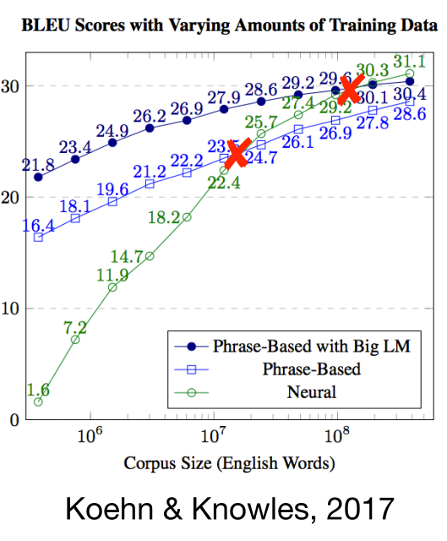
Where will you get so many bilingual texts?
NMT starts to compete with SMT at 10m parallel words, or ~1m sentences
What about resource-poor languages?
Can we translate with only monolingual texts?

Slide 29
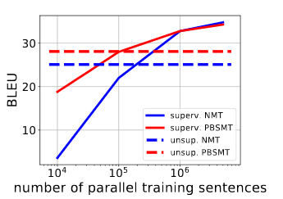
Where will you get so many bilingual texts?
NMT starts to compete with SMT at 10m parallel words, or ~1m sentences
What about resource-poor languages?
Can we translate with only monolingual texts?
Lample et al. 18'

Slide 30
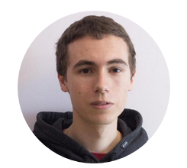


And then, two labs stepped forward...
University of the Basque Country
A method for fully unsupervised cross-lingual mappings of word embeddings (ACL 18')
Unsupervised Statistical Machine Translation (EMNLP 18')
Facebook AI Research France
Word translation without parallel data (ICLR 18')
Phrase-Based & Neural Unsupervised Machine Translation (EMNLP 18')
Mikel Artetxe et al.
Guillaume Lample et al.
https://github.com/artetxem/vecmap
https://github.com/facebookresearch/UnsupervisedMT

Slide 31
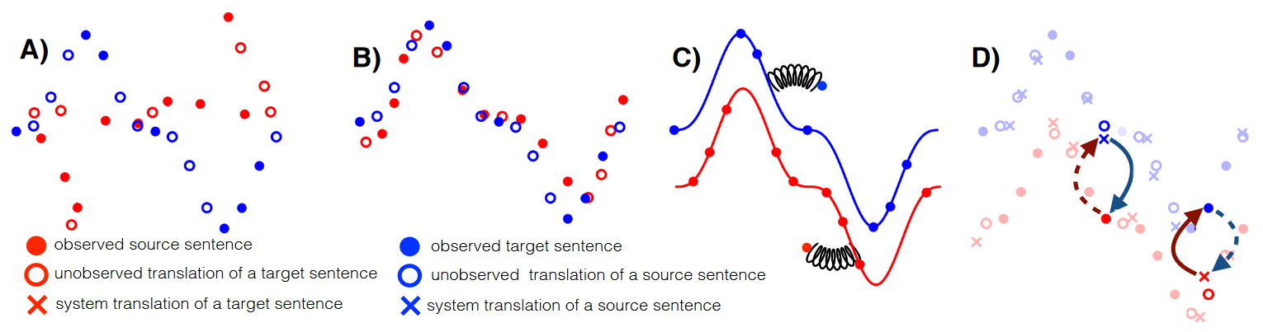
Main Principles
Learn a bilingual dictionary unsupervised-ly
Denoise translations (for fluency), leveraging language models
Back Translation: use the source-to-target MT to create synthetic examples to train the target-to-source MT, and vice versa

Slide 32
Main Principles of Unsupervised MT
Learn a bilingual dictionary unsupervised-ly
Denoise translations (for fluency), leveraging language models
Back Translation: use the source-to-target MT to create synthetic examples to train the target-to-source MT, and vice versa

Slide 33
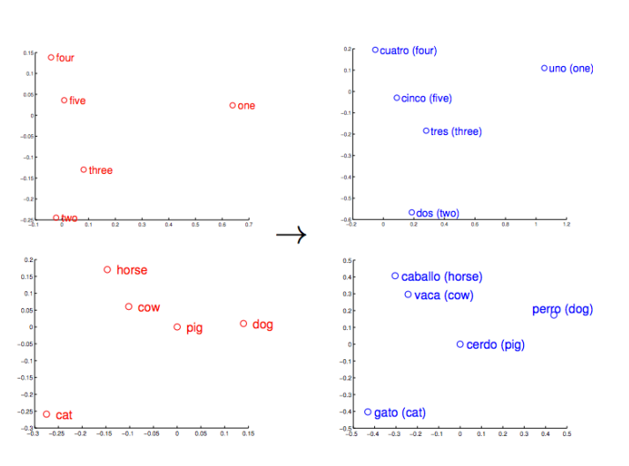
Learn a bilingual dictionary - motivation
Mikolov et al. 2013
Observed that word embedding spaces exhibit similar structures across languages
Used 5k word translations as the initial anchors for iteratively learning a linear mapping, or rotation

Slide 34
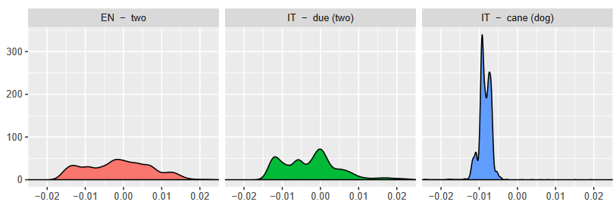
Learn a bilingual dictionary – Artetxe et al.
To lose the supervised initialization, you can find similar word pairs by comparing word similarity distributions
Then iteratively improve this solution

Slide 35
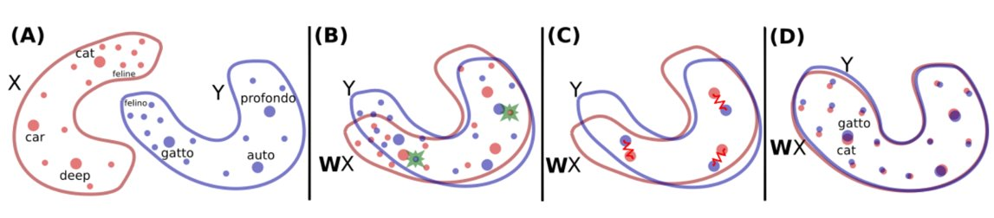
Learn a bilingual dictionary – Lample et al.

Slide 36
Learn a bilingual dictionary
Two distributions of word mbeddings in separate languages

Slide 37
Learn a bilingual dictionary
Adversarial Learning: Discriminator vs. Mapper
Discriminator – distinguish between target vecs and mapped source vecs
Mapper – train a W that will fool D
Minimize loss funcs

Slide 38
Learn a bilingual dictionary
Refinement of W
Retain only the high-quality entries: the most frequent words, that are mutual nearest neigbors
Apply the Procrustes solution (Xing et al. 15')

Slide 39
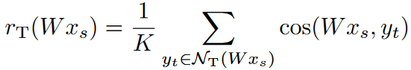
Learn a bilingual dictionary
felino
feline
Translate using Cross-domain Similarity Local Scaling (CSLS)
We can't trust Nearest Neighbors (NN) to map words, because some words are NN of many (hubs), and some are NN of few (isolated)
AKA The curse of Dimentionality, or The Hubness Problem (Dinu et al. 15')
So, consider the mean similarity of a word to its neighbors:
Instead of NN, use CSLS similarity:

Slide 40
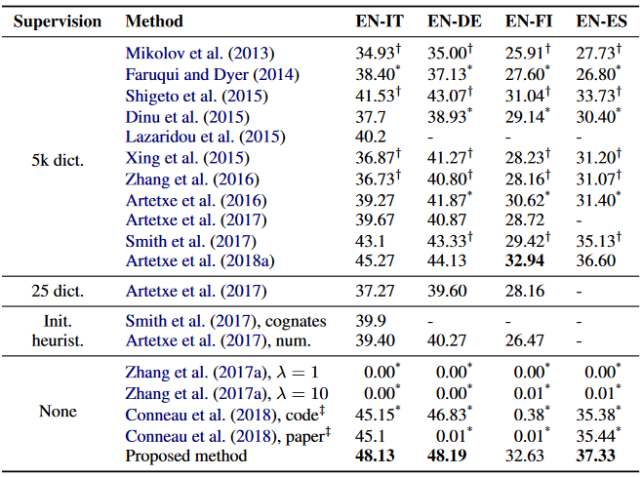
Learn a bilingual dictionary – results Artetxe et al.
Dataset of Dinu et al. 15'
Beats supervised methods!
Best of breed in several languages
Also works for a tough language like FI

Slide 41
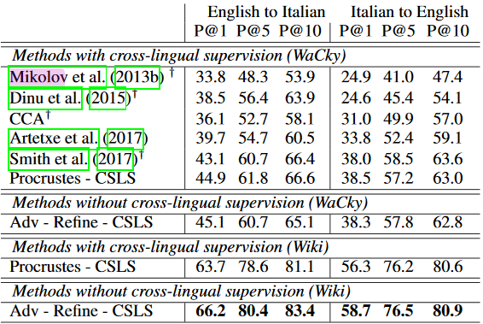
Learn a bilingual dictionary – results Lample et al.
Dataset of Dinu et al. 15'
Best of breed in several languages
Also reported lower but impressive results on FR, DE, ES,
Even RU, Traditional Chinese and Esperanto
Still unclear which of these two is better...

Slide 42
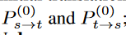
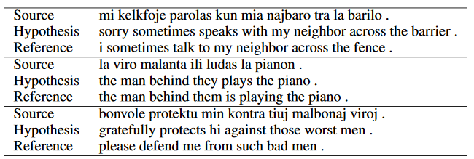
Learn a bilingual dictionary - usage
With this unsupervised bilingual dictionary, we construct the first iteration of our translation models, one in each direction:
Word-per-word translation is bad... but good enough to bootstrap our model

Slide 43
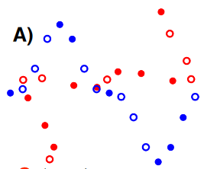
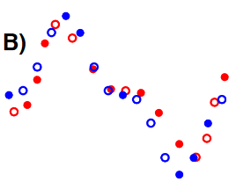
Learn a bilingual dictionary - usage
With this unsupervised bilingual dictionary, we construct the first iteration of our translation models, one in each direction:
Word-per-word translation is bad... but good enough to bootstrap our model

Slide 44
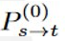
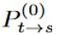
Learn a bilingual dictionary - usage
is the composition of an encoder from the source language to latent space, and a decoder from latent space to the target language:
= dec(enc(x, S), T)
is the corresponding composition:
= dec(enc(y, T), S

Slide 45
Main Principles of Unsupervised MT
Learn a bilingual dictionary unsupervised-ly
Denoise translations (for fluency), leveraging language models
Back Translation: use the source-to-target MT to create synthetic examples to train the target-to-source MT, and vice versa

Slide 46
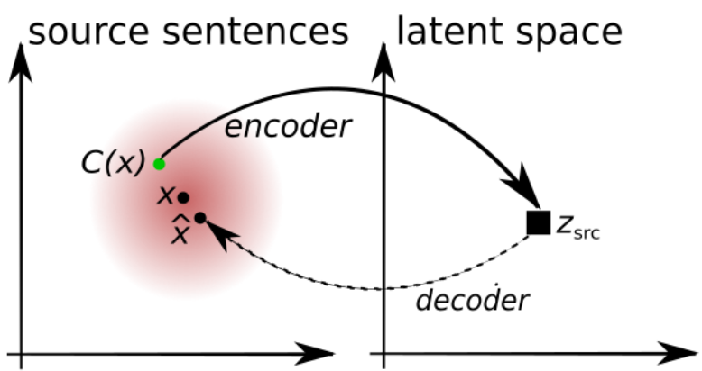
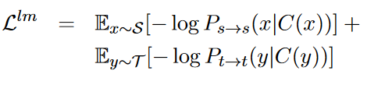
Denoise translations
x – the source sentence (but also the target sentece)
C(x) - a noisy version of x, with random words swapped/droped
z – the encoding (mapping) of x to latent space
x^ - the decoding (reconstruction) of x, back to the source language

Slide 47
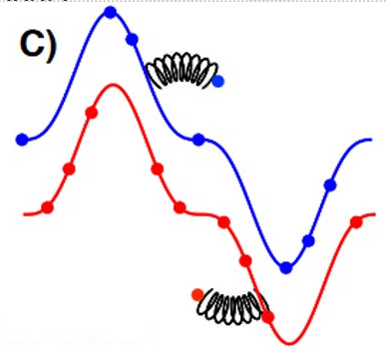
Denoise translations
x – the source sentence (but also the target sentece)
C(x) - a noisy version of x, with random words swapped/droped
z – the encoding (mapping) of x to latent space
x^ - the decoding (reconstruction) of x, back to the source language
Further train encoder and decoder by minimizing the loss:

Slide 48
Main Principles of Unsupervised MT
Learn a bilingual dictionary unsupervised-ly
Denoise translations (for fluency), leveraging language models
Back Translation: use the source-to-target MT to create synthetic examples to train the target-to-source MT, and vice versa

Slide 49
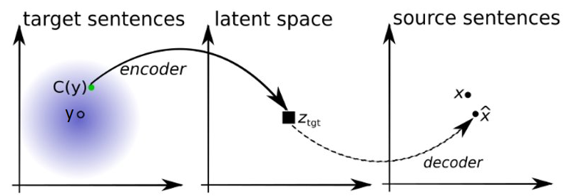
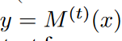
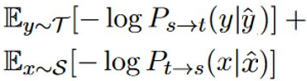
Back Translation
x – a sentence in the source language
y – a translation of x, produced by the model, at iteration t:
C(y) - a noisy version of y
z – the encoding (mapping) of C(y) from the target langugage to latent space
x^ - the decoding of z, to the source language
Further train encoder and decoder by minimizing the loss:

Slide 50
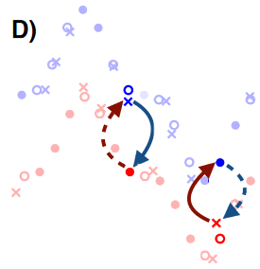
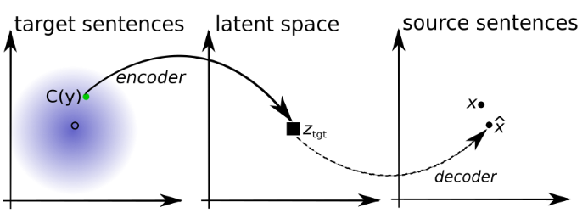
Back Translation
x – a sentence in the source language
y – a translation of x, produced by the model, at iteration t:
C(y) - a noisy version of y
z – the encoding (mapping) of C(y) from the target langugage to latent space
x^ - the decoding of z, to the source language
Further train encoder and decoder by minimizing the loss:

Slide 51
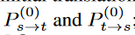
Putting it all together – Algo. for unsupervised MT
Language models: Learn Word Embedding models P_{t} and P_{s} over source and target language
Use P_{t} and P_{s} to learn a bilingual dictionary
Use the dictionary to learn two initial translation models, one in each direction:
For k=1 to N (or until convergence*) do
Denoising
Back-translation

Slide 52

Putting it all together – NMT Architecture and training objectives
Denoising
Back-translation
Lample et al.

Slide 53
Putting it all together
Both research groups +-adhere to these principles
Artetxe et al. publish an NMT model, and then a better SMT model
Lample et al. publish an NMT model and then a better composite SMT+NMT model

Slide 54

Results
Compared to other unsupervised methods on the WMT 14' EN-FR, and WMT 16' EN-DE Benchmarks
Still much worse than the SOTA, but they're closing the gap fast!
Lample et al.
Artetxe et al., 18' NMT | 15.13 | 15.56 | - | -
Artetxe et al., 18' SMT | 26.22 | 25.87 | 18.23 | 23.05
WMT SOTA (supervised) | 35.8 | 35.0 | 34.2 | 40.2

Slide 55

Results
Compared to supervised versions of the same models
Unsupervised methods are becoming a promising tool, when you have < 100K parallel sentences
Lample et al.

Slide 56

Examples
Artetxe et al.

Slide 57

Examples
Lample et al.

Slide 58

Examples
Lample et al.

Slide 59

Examples
Lample et al.

Slide 60
Questions?
Denoising
Back-translation
Lample et al.

Slide 61
Thank you!

